Slide 1




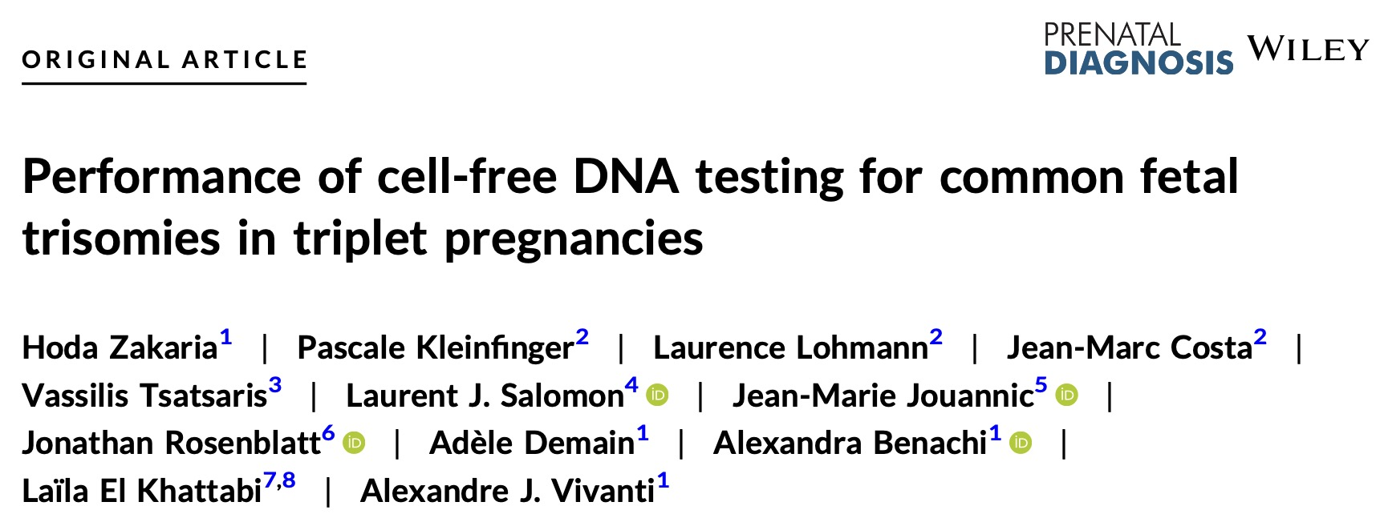

Gynécologie-Obstétrique
Hôpital
Antoine Béclère
AP-HP

Slide 2
Introduction
In SINGLETON pregnancies, the use of cell‐free DNA (cfDNA) analysis as a screening test for common fetal trisomies has spread worldwide

Slide 3
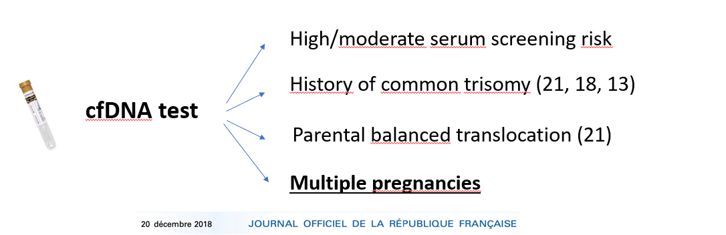
SINGLETON pregnancies

Slide 4

cfDNA routine activity in France
2022 : cfDNA screening
≈ 130 000 tests
18% of total number of livebirths
→ 40% drop of Karyotypes w/wo a-CGH

Slide 5
SINGLETON pregnancies

Slide 6

cfDNA challenges in multiple pregnancies
+/-
→ Increased risk of no call results (vs singletons)
Bevilacqua, 2015 ; Galeva, 2019
→ Difficulties in estimating predictive performance (low rates of T13 & 18)
Judah, 2021
→ Impact of vanishing twins (FPR)
Van Eekhout, 2023
→ Choronicity in the diagnostic strategy
→ Higher risk of miscarriage in case of invasive testing
Vink, 2012

Slide 7

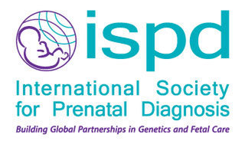

cfDNA in multiple pregnancies / guidelines
2020
« Cell-free DNA screening can be performed in twin pregnancies »
/
« The use of first trimester cfDNA screening for the common autosomal trisomies is appropriate for twin pregnancies »
« Screening options for triplet pregnancies are lacking and cfDNA may be a potential option »
2020
« ACMG strongly recommends NIPS over traditional screening methods for all pregnant patients with twin gestations for fetal trisomies 21, 18, and 13»
2021
/

Slide 8
cfDNA in triplet pregnancies / Pitfalls
Studies with > 10 triplet pregnancies
Positive call
Study
Technology
Population
No call rate
T21
T18
T13
Chen 2019
NGS
85 triplets
?
n = 0
n = 0
n = 0
Dyr 2020
NGS
709 triplets / 50 full outcome
21.3 %
n = 0
n = 0
n = 0
Van Riel 2021
NGS
25 triplets
?
n = 0
n = 0
n = 0

Slide 9
cfDNA in triplet pregnancies
Current study / Inclusion criteria
Retrospective cohort study
Triplet pregnancies
« First tier » test
Common trisomies (T21, T18, T13)
NGS : VeriSeq NIPT v1 Illumina®
01/2017 → 01/2020

Slide 10
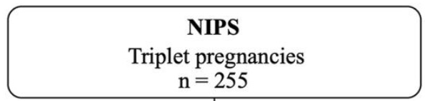
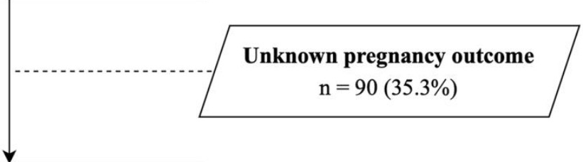
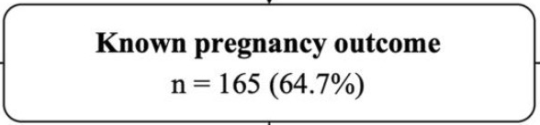
cfDNA in triplet pregnancies

Slide 11
cfDNA in triplet pregnancies
Demographics | Cohort with known outcomes n = 165
Maternal age (years), median [IQR] | 33 [29-36] range [18-44]
Body Mass Index (kg/m²), median [IQR] | 23.4 [21-27.4] range [17.2-45.8]
Gestational age at cfDNA analysis (weeks), median [IQR] | 13.5 [12.2-16] range [11.2-30.1]
Fetal fraction at cfDNA analysis (%), median [IQR] | 14 [11-18] range [2-28]
Assisted reproductive technology, n (%) | 103 (62.4)
Chorionicity
Trichorionic-triamniotic, n (%) | 98 (59.4)
Dichorionic-triamniotic, n (%) | 40 (24.2)
Monochorionic-triamniotic, n (%) | 18 (10.9)
Unknown | 9 (5.5)

Slide 12
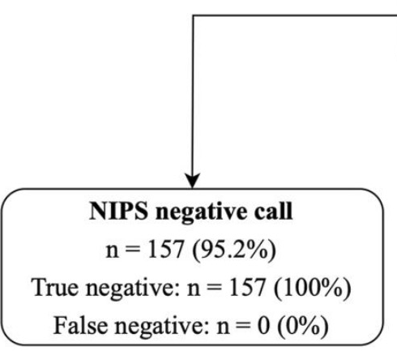
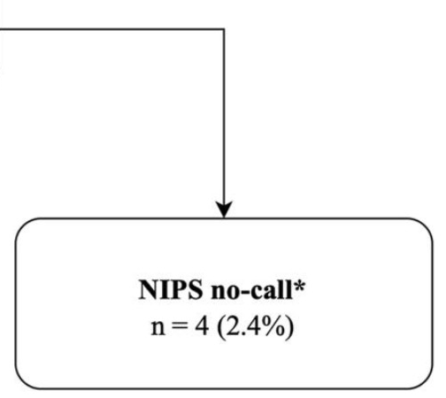
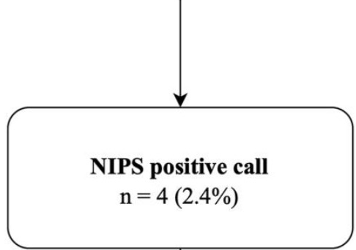
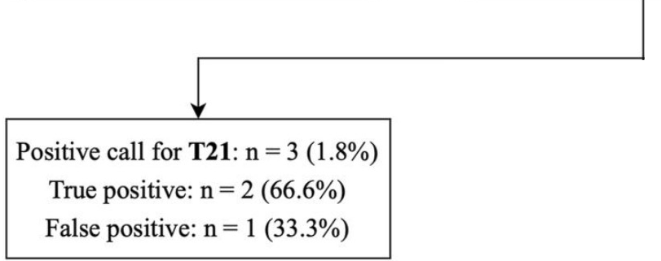
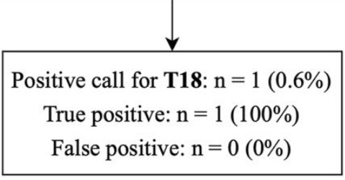
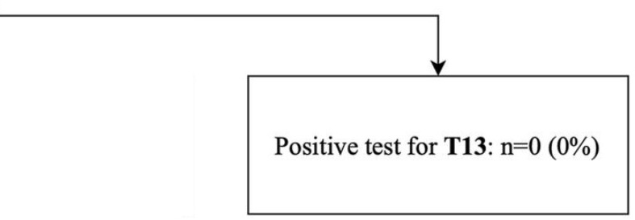
cfDNA in triplet pregnancies
No false negative
1.2% at 2nd sampling
0.6% at 3rd sampling

Slide 13
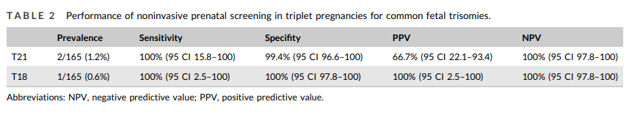

Slide 14

Focus: embryo reduction
« When it makes it possible to reduce the risks of a pregnancy whose multiple nature endangers the health of the woman, the embryos or the fetuses, the partial voluntary interruption of a multiple pregnancy may be performed before the end of the fourteenth week »
Article L2213-1 modifié par LOI n°2021-1017 du 2 août 2021 - art. 28
Before cfDNA results
n = 18/58 (31%)
Embryo reductions
N = 58/255 (22.7%)
After cfDNA results
n = 40/58 (69%)

Slide 15
Focus: embryo reduction
In case of reduction demand:
1/ Early 1st trimester scan - 11 weeks
2/ cfDNA
3/ Reduction < 14 weeks

Slide 16
cfDNA in triplet pregnancies
Large cohort of triplet pregnancies with full outcome
No call rate = 2.4% at first sampling
No false negative results
Correct detection of the 3 common fetal trisomies
One FP T21 call (placental confined mosaïcism)
« Screening options for triplet pregnancies are lacking and cfDNA may be a potential option »

